Slide 1
CSC230
Searching and Asymptotic Complexity

Slide 2
What Makes a Good Algorithm?
Suppose you have two possible algorithms or data structures that basically do the same thing; which is better?
Well… what do we mean by better?
Faster?
Less space?
Easier to code?
Easier to maintain?
Required for homework?
How do we measure time and space for an algorithm?

Slide 3
Sample Problem: Searching
Determine if sorted array b contains integer v
First solution: Linear Search (check each element)
/** return true iff v is in b */
bool find(int* b, int length, int v) {
for (int i = 0; i < length; i++) {
if (b[i] == v) return true;
}
return false;
}
Doesn’t make use of fact that b is sorted.

Slide 4
Sample Problem: Searching
Second solution: Binary Search
bool find (int* a, int length, int v) {
int low= 0;
int high= length - 1;
while (low <= high) {
int mid = (low + high)/2;
if (a[mid] == v) return true;
if (a[mid] < v)
low= mid + 1;
else high= mid - 1;
}
return false;
}
Still returning true iff v is in a
Keep true: all occurrences of
v are in
b[low..high]

Slide 5
Linear Search vs Binary Search
Which one is better?
Linear: easier to program
Binary: faster… isn’t it?
How do we measure speed?
Experiment?
Proof?
What inputs do we use?
Simplifying assumption #1: Use size of input rather than input itself
For search problem, input size is n where n is array size
Simplifying assumption #2: Count number of “basic steps” rather than computing exact times

Slide 6
One Basic Step = One Time Unit
Basic step:
Input/output of scalar value
Access value of scalar variable, array element, or object field
assign to variable, array element, or object field
do one arithmetic or logical operation
method invocation (not counting arg evaluation and execution of method body)
For conditional: number of basic steps on branch that is executed
For loop: (number of basic steps in loop body) * (number of iterations)
For method: number of basic steps in method body (include steps needed to prepare stack-frame)

Slide 7
Runtime vs Number of Basic Steps
Is this cheating?
The runtime is not the same as number of basic steps
Time per basic step varies depending on computer, compiler, details of code…
Well … yes, in a way
But the number of basic steps is proportional to the actual runtime
Which is better?
n or n² time?
100 n or n² time?
10,000 n or n² time?
As n gets large, multiplicative constants become less important
Simplifying assumption #3: Ignore multiplicative constants

Slide 8
Using Big-O to Hide Constants
We say f(n) is order of g(n) if f(n) is bounded by a constant times g(n)
Notation: f(n) is O(g(n))
Roughly, f(n) is O(g(n)) means that f(n) grows like g(n) or slower, to within a constant factor
"Constant" means fixed and independent of n
Example: (n² + n) is O(n²)
We know n ≤ n² for n ≥1
So n² + n ≤ 2 n² for n ≥1
So by definition, n² + n is O(n²) for c=2 and N=1
Formal definition: f(n) is O(g(n)) if there exist constants c and N such that for all n ≥ N, f(n) ≤ c·g(n)

Slide 9
A Graphical View
9
c·g(n)
f(n)
N
To prove that f(n) is O(g(n)):
Find N and c such that f(n) ≤ c g(n) for all n > N
Pair (c, N) is a witness pair for proving that f(n) is O(g(n))

Slide 10
Big-O Examples
Claim: 100 n + log n is O(n)
We know log n ≤ n for n ≥ 1
So 100 n + log n ≤ 101 n
for n ≥ 1
So by definition,
100 n + log n is O(n)
for c = 101 and N = 1
Claim: log_{B} n is O(log_{A} n)
since log_{B} n = (log_{B} A)(log_{A} n)
Question: Which grows faster: n or log n?

Slide 11
Big-O Examples
Let f(n) = 3n² + 6n – 7
f(n) is O(n²)
f(n) is O(n³)
f(n) is O(n⁴)
…
g(n) = 4 n log n + 34 n – 89
g(n) is O(n log n)
g(n) is O(n²)
h(n) = 20·2^{n} + 40n
h(n) is O(2^{n})
a(n) = 34
a(n) is O(1)
Only the leading term (the term that grows most rapidly) matters

Slide 12
Problem-Size Examples
Consisider a computing device that can execute 1000 operations per second; how large a problem can we solve?
 | 1 second | 1 minute | 1 hour
n | 1000 | 60,000 | 3,600,000
n log n | 140 | 4893 | 200,000
n² | 31 | 244 | 1897
3n² | 18 | 144 | 1096
n³ | 10 | 39 | 153
2^{n} | 9 | 15 | 21

Slide 13
Commonly Seen Time Bounds
O(1) | constant | excellent
O(log n) | logarithmic | excellent
O(n) | linear | good
O(n log n) | n log n | pretty good
O(n²) | quadratic | OK
O(n³) | cubic | maybe OK
O(2^{n}) | exponential | too slow

Slide 14
Worst-Case/Expected-Case Bounds
May be difficult to determine time bounds for all imaginable inputs of size n
Simplifying assumption #4: Determine number of steps for either
worst-case or
expected-case or average case
Worst-case
Determine how much time is needed for the worst possible input of size n
Expected-case
Determine how much time is needed on average for all inputs of size n

Slide 15
Simplifying Assumptions
Use the size of the input rather than the input itself – n
Count the number of “basic steps” rather than computing exact time
Ignore multiplicative constants and small inputs (order-of, big-O)
Determine number of steps for either
worst-case
expected-case
These assumptions allow us to analyze algorithms effectively

Slide 16
Worst-Case Analysis of Searching
Binary Search
// Return h that satisfies
// b[0..h] <= v < b[h+1..]
bool bsearch(int* b, int length, int v){
int h= -1; int t= length;
while ( h != t-1 ) {
int e= (h+t)/2;
if (b[e] <= v) h= e;
else t= e;
}
}
Linear Search
// return true iff v is in b
bool find(int* b, int length, int v) {
for (int i = 0; i < length; i++) {
if (b[i] == v) return true;
}
return false;
}
worst-case time: O(n)
Always takes ~(log n+1) iterations.
Worst-case and expected times:
O(log n)

Slide 17
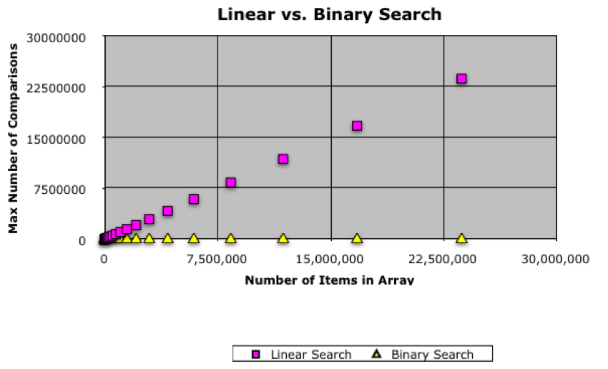
Comparison of linear and binary search

Slide 18
Analysis of Matrix Multiplication
Multiply n-by-n matrices A and B:
Convention, matrix problems measured in terms of n, the number of rows, columns
Worst-case time: O(n³)
Expected-case time:O(n³)
for (i = 0; i < n; i++)
for (j = 0; j < n; j++) {
c[i][j] = 0;
for (k = 0; k < n; k++)
c[i][j] += a[i][k]*b[k][j];
}

Slide 19
Remarks
Once you get the hang of this, you can quickly zero in on what is relevant for determining asymptotic complexity
Example: you can usually ignore everything that is not in the innermost loop. Why?
One difficulty:
Determining runtime for recursive programs Depends on the depth of recursion

Slide 20
Why Bother with Runtime Analysis?
Computers so fast that we can do whatever we want using simple algorithms and data structures, right?
Not really – data-structure/algorithm improvements can be a very big win
Scenario:
A runs in n² msec
A' runs in n²/10 msec
B runs in 10 n log n msec
Problem of size n=10³
A: 10³ sec ≈ 17 minutes
A': 10² sec ≈ 1.7 minutes
B: 10² sec ≈ 1.7 minutes
Problem of size n=10⁶
A: 10⁹ sec ≈ 30 years
A': 10⁸ sec ≈ 3 years
B: 2·10⁵ sec ≈ 2 days
1 day = 86,400 sec ≈ 10⁵ sec
1,000 days ≈ 3 years

Slide 21
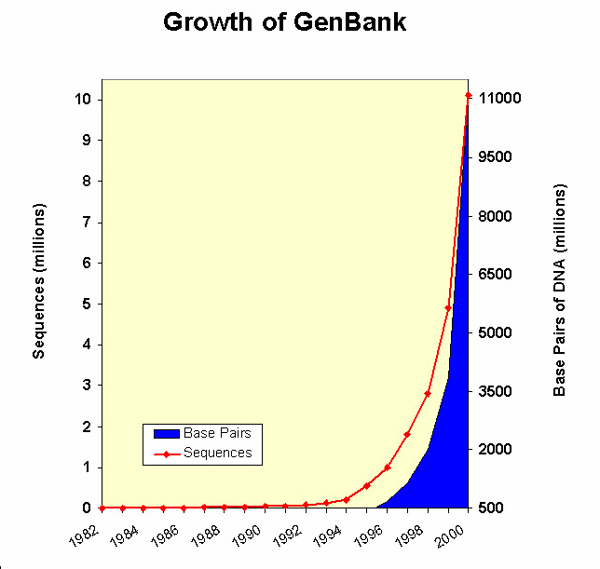
Algorithms for the Human Genome
Human genome = 3.5 billion nucleotides ~ 1 Gb
@1 base-pair instruction/μsec
n² → 388445 years
n log n → 30.824 hours
n → 1 hour

Slide 22
Limitations of Runtime Analysis
Big-O can hide a very large constant
Example: selection
Example: small problems
The specific problem you want to solve may not be the worst case
Example: Simplex method for linear programming
Your program may not be run often enough to make analysis worthwhile
Example: one-shot vs. every day
You may be analyzing and improving the wrong part of the program
Very common situation
Should use profiling tools

Slide 23
Summary
Asymptotic complexity
Used to measure of time (or space) required by an algorithm
Measure of the algorithm, not the problem
Searching a sorted array
Linear search: O(n) worst-case time
Binary search: O(log n) worst-case time
Matrix operations:
Note: n = number-of-rows = number-of-columns
Matrix-vector product: O(n²) worst-case time
Matrix-matrix multiplication: O(n³) worst-case time
More later with sorting and graph algorithms

